Slide 1


FEATURE EXTRACTION USING KNAPSACK
Layla Lahham
Leen Masarweh
Dana Abu Al_Ruz
Supervised by: Prof.Basima shoqurat

Slide 2


UNDERSTANDING AI
Artificial Intelligence (AI): refers to the simulation of human intelligence by machines, ensuring that systems can learn, reason, and make decisions automatically.
AI systems rely mainly on three core components:
Data—the foundation of learning and decision-making
Algorithms—the logic and methods used to process data
Hardware (GPUs/CPUs)—the computational power required to handle complex tasks
The performance of any AI model strongly depends on:
The quality of data
The relevance of features
The efficiency of the learning algorithm
Without meaningful features, even the most advanced models fail to perform well.

Slide 3


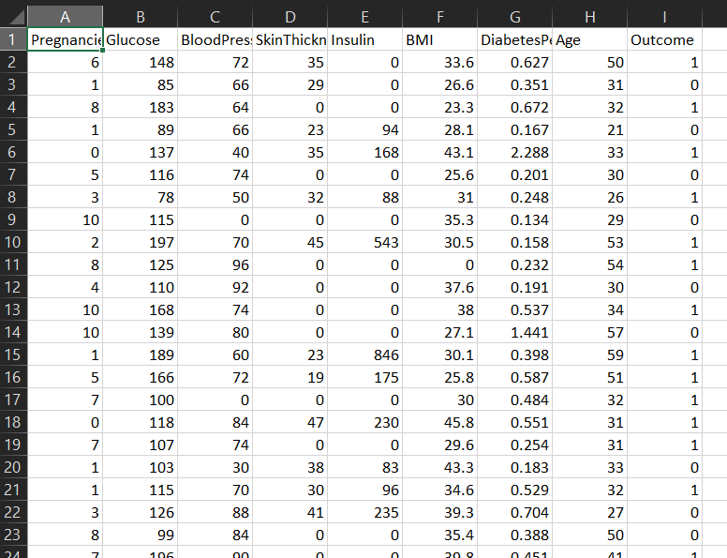
The influence of the features on the model

Slide 4
The influence of the features on the models

Slide 5
THE CHALLENGE BEHIND GOOD MODELS
Manual feature selection works only for small datasets
As data grows:
Number of features increases
Data becomes complex & high-dimensional
Relationships between features are often unclear
Leads to:
Missing important features
Keeping redundant or irrelevant ones
Lower model performance
Slower training
Selecting the right features becomes a real challenge for humans

Slide 6


EXISTING FEATURE SELECTION APPROACHES
Select
From Model
L1
Regularization
Filter Methods
Wrapper
Methods

Slide 7

BEYOND ACCURACY: THE VALUE OF COST-AWARE SELECTION
(Knapsack) is considered an advanced approach because it incorporates a 'Cost' factor—something not directly provided by the standard libraries mentioned before, as they focus solely on Accuracy.

Slide 8

Mapping ML to Knapsack
Item
Value
Weight
Capacity
Accuracy
+
Explainability
Feature
Cost
Budget

Slide 9
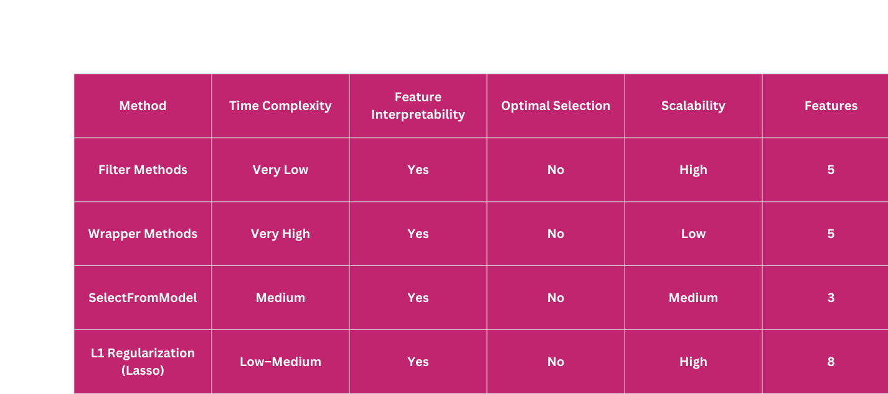
FEATURE SELECTION COMPARISON
To ensure a fair comparison, all feature selection methods were evaluated using the same Random Forest classifier.

Slide 10


THANK YOU!

